Slide 1
DR SNSRCAS, CBE Cloud Technology Fundaments 21UCA501 II BCA “B” ODD SEM UNIT II Basic Principles of Cloud Computing

Slide 2
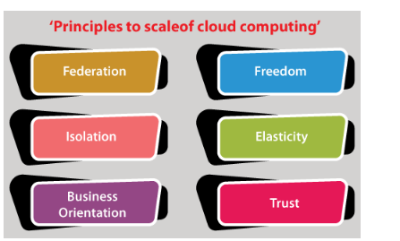
Basic Principles of Cloud Computing

Slide 3
Basic Principles of Cloud Computing
1. Federation
Cloud resources are always unlimited for customers, but each cloud has a limited capacity. If customer demand continues to grow, the cloud will have to exceed its potential, for which the form federation of service providers enables collaboration and resource sharing.
A federated cloud must allow virtual applications to be deployed on federated sites. Virtual applications should not be location-dependent and should be able to migrate easily between sites. Union members should be independent, making it easier for competing service providers to form unions.
2. Freedom
Cloud computing services should provide end-users complete freedom that allows the user to use cloud services without depending on a specific cloud provider.
Even the cloud provider should be able to manage and control the computing service without sharing internal details with customers or partners.

Slide 4
Basic Principles of Cloud Computing
3. Isolation
We are all aware that a cloud service provider provides its computing resources to multiple end-users. The end-user must be assured before moving his computing cloud that his data or information will be isolated in the cloud and cannot be accessed by other members sharing the cloud.
4. Elasticity
Cloud computing resources should be elastic, which means that the user should be free to attach and release computing resources on their demand.
5. Business Orientation
Companies must ensure the quality of service providers offer before moving mission-critical applications to the cloud. The cloud service provider should develop a mechanism to understand the exact business requirement of the customer and customize the service parameters as per the customer's requirement.

Slide 5
Basic Principles of Cloud Computing
6. Trust
Trust is the most important factor that drives any customer to move their computing to the cloud. For the cloud to be successful, trust must be maintained to create a federation between the cloud customer, the cloud vendor, and the various cloud providers.
So, these are the principles of cloud computing that take advantage of the Internet to enhance cloud computing. A cloud provider considers these principles before deploying cloud services to end-users.

Slide 6
THANK YOU

